Slide 1
Analysing the Impact of Gaming Hours on Academic and Work Performance
By Raphael Floku Ayertey

Slide 2
INTRODUCTION & BACKGROUND
With the rapid growth of digital gaming, concerns have emerged regarding its potential effects on academic achievement and workplace productivity. While gaming can offer cognitive and stress relief benefits, excessive gaming may negatively influence sleep patterns, focus levels, stress, and overall performance.
This study aims to analyse the relationship between gaming behaviour (daily and weekly gaming hours, game type, and gaming time) and performance outcomes such as academic or work scores, productivity levels, and perceived performance impact.

Slide 3
PROBLEM STATEMENT
There is limited data driven evidence that clearly explains:
1. How gaming hours affect academic or work performance
2. Whether gaming influences productivity, focus, stress, and sleep
3. Which gaming patterns are beneficial versus harmful
This project seeks to bridge that gap using structured data analysis and visualization

Slide 4
OBJECTIVES OF THE STUDY
The main objectives of this analysis are to:
1. Examine the relationship between daily and weekly gaming hours and academic or work performance.
2. Analyse how sleep hours, stress level, and focus level mediate the effect of gaming on performance.
3. Identify gaming patterns that lead to high productivity versus negative performance impact.
4. Compare performance outcomes across age groups, gender, occupation, and game types.
5. Provide data-driven recommendations for balanced gaming habits.

Slide 5
DATASET DESCRIPTION
The dataset contains individual-level data with the following key variables:
Demographics: User ID, Age, Gender, Occupation
Gaming Behaviour: Game Type, Daily Gaming Hours, Weekly Gaming Hours, Primary Gaming Time
Well-being Indicators: Sleep Hours, Stress Level, Focus Level
Performance Metrics: Academic or Work Score, Productivity Level, Performance Impact
Each row represents a unique user, allowing both behavioural and outcome-based analysis.

Slide 6
DATA CLEANING AND INSPECTION
Checked for missing values – no missing data found
Checked for duplicate records – no duplicates detected
Verified data consistency and structure
Cleaned column headers by removing unnecessary spaces in Excel
Ensured all variables were correctly formatted for analysis

Slide 7
ANALYSIS

Slide 8
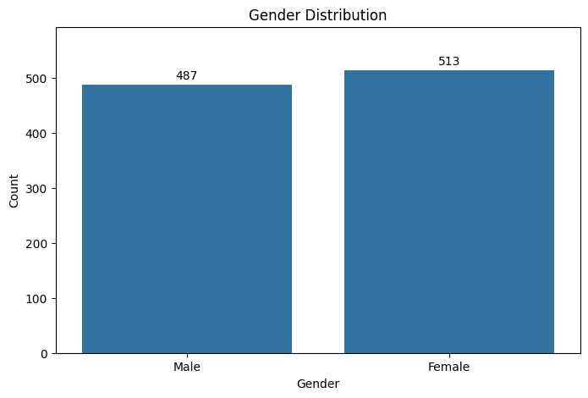
GENDER DISTRIBUTION
For gender distribution, Females dominated the dataset.

Slide 9
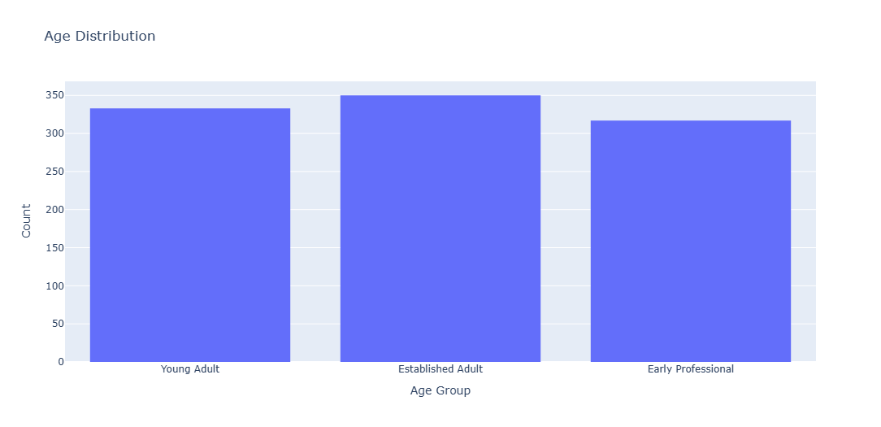
AGE CLASSIFICATION AND DISTRIBUTION
Young Adult= 18-23
Est Adult= 24-29
Early Prof= 30-35

Slide 10
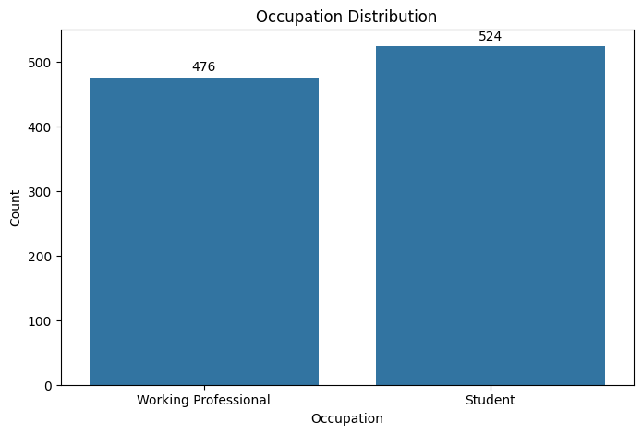
OCCUPATION DISTRIBUTION
Students were more than working professionals in the dataset.

Slide 11
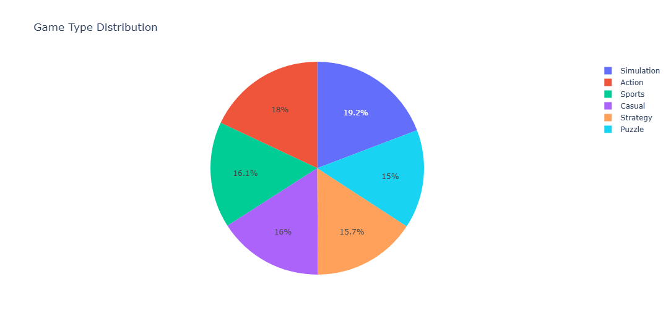
GAME TYPE DISTRIBUTION
Simulation games were mostly played by the users.

Slide 12
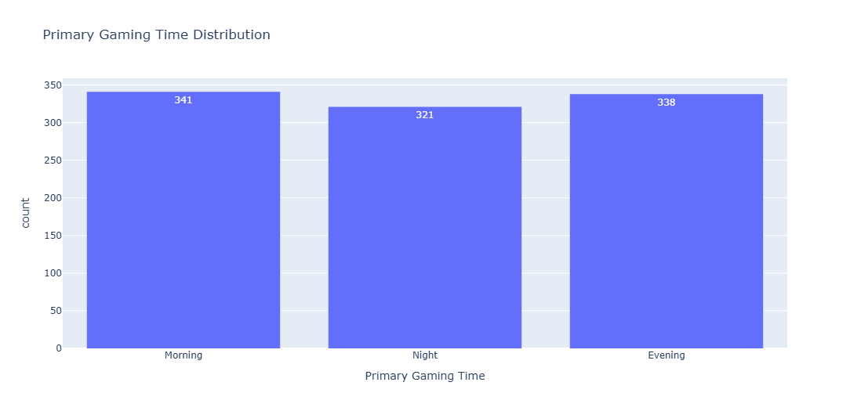
GAME TIME DISTRIBUTION
Most people play games in the morning.

Slide 13
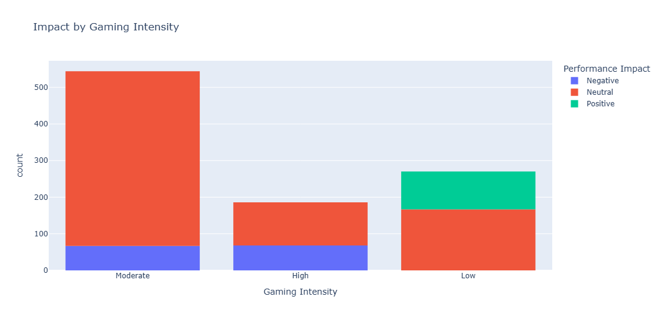
IMPACT BY GAMING INTENSITY

Slide 14
INSIGHT ON GAMING INTENSITY
The analysis reveals that gaming intensity does not have a uniform impact on academic performance; instead, it follows a clear threshold pattern. Low-intensity gamers show the highest potential for academic benefit (38% positive impact), while Moderate gamers (1-3 hours) enjoy a safe harbour where nearly 88% maintain neutral performance with minimal risk. However, once gaming reaches High intensity, the probability of a negative impact triples compared to the moderate group. This suggests that academic risk is not driven by gaming itself, but by the loss of time management that occurs once play exceeds the moderate threshold

Slide 15
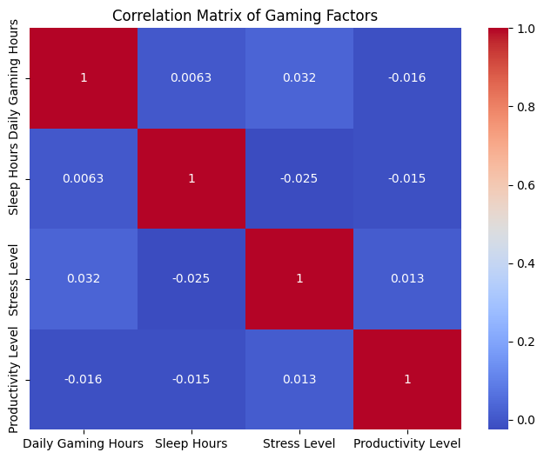
CORRELATION MATRIX OF GAMING FACTORS

Slide 16
INSIGHT ON CORRELATION MATRIX
The correlation matrix reveals a surprising lack of a strong linear relationship between Daily Gaming Hours, Sleep, Stress, and Productivity. With all correlation coefficients hovering near zero (between -0.03 and +0.03), the data suggests that these variables operate independently within this dataset. Specifically, an increase in gaming hours does not automatically trigger a decrease in sleep or a spike in stress levels. This indicates that students may be successfully compartmentalizing their gaming habits, or that the impact of gaming on life balance is highly individual and cannot be captured by a simple linear trend.

Slide 17
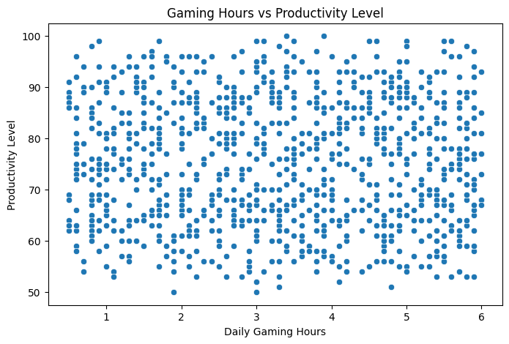
GAMING HOURS AND PRODUCTIVITY
The analysis revealed a correlation coefficient of -0.02, indicating a negligible negative linear relationship between gaming hours and productivity levels. This result suggests that within the study group, there is no meaningful connection between the time spent gaming and an individual’s productivity

Slide 18
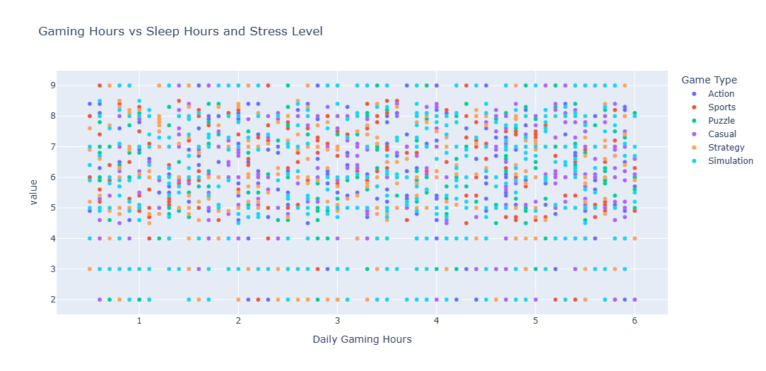
GAMING HOURS VS SLEEP HOURS AND STRESS LEVEL

Slide 19
INSIGHT ON GAMING HOURS VS SLEEP HOURS AND STRESS LEVEL
0.01 (Gaming vs. Sleep): This value is virtually zero. It suggests that there is no consistent linear pattern between the number of hours spent gaming and sleep levels. An increase in gaming hours does not reliably predict an increase or decrease in sleep in this dataset.
0.03 (Gaming vs. Stress): While technically positive, a 0.03 correlation is considered "extremely weak". It indicates that for this specific sample, gaming hours have almost no impact on stress levels.
While gaming does not show a strong statistical relationship with sleep or stress, its indirect effects such as reduced focus, fatigue, and time mismanagement can still negatively influence academic and work performance when gaming hours become excessive

Slide 20
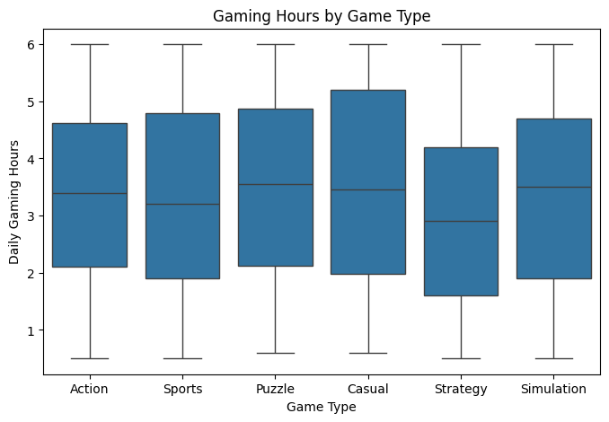
GAMING HOURS BY GAME TYPE
The results show that gaming hours differ significantly by game type. Competitive and online games tend to encourage longer gaming sessions, while casual games are played for shorter durations. This highlights the importance of game design in influencing gaming behaviour and its potential impact on productivity and well being.

Slide 21
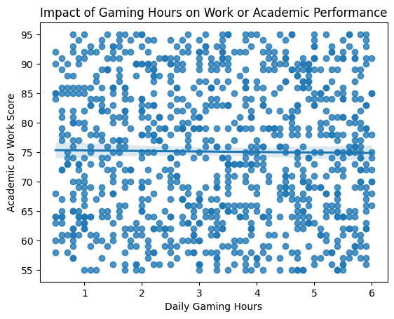
IMPACT OF GAMING ON WORK OR ACADEMIC PERFORMANCE
There is a moderate negative correlation between gaming and academics. As daily gaming hours increase, academic performance generally declines, though the scatter suggests that gaming is only one of many factors affecting a student's grades.

Slide 22
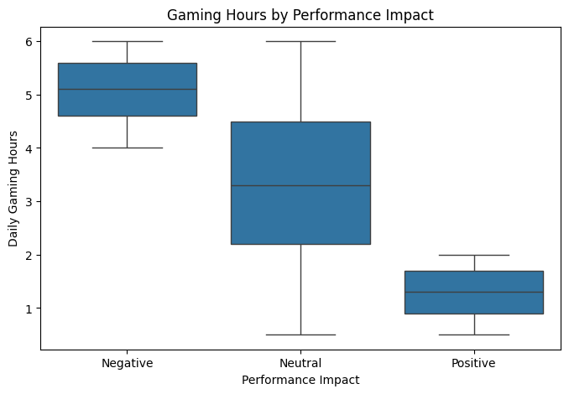
IMPACT OF GAMING ON PERFORMANCE IMPACT

Slide 23
INSIGHT ON EFFECT OF GAMING ON PERFORMANCE IMPACT
The box plot shows a clear relationship between gaming hours and performance impact. Individuals who experience negative performance effects spend the most time gaming, with daily hours concentrated around 5–6 hours. Those with neutral performance impact show moderate gaming time, typically around 2–4 hours per day. In contrast, individuals with positive performance outcomes spend the least amount of time gaming, mostly between 1–2 hours daily. This pattern suggests that higher gaming hours are associated with poorer performance, while limited and controlled gaming is more likely to support or maintain good academic or work performance.

Slide 24
KEY FINDINGS
Increased gaming hours are associated with reduced sleep duration and Stress levels tend to rise with excessive gaming : Results indicate that higher gaming hours are associated with reduced sleep duration and increased stress levels. Sleep deprivation caused by prolonged gaming sessions may contribute to heightened stress and reduced cognitive performance.
Productivity and academic/work performance decline after prolonged gaming: The analysis reveals a negative relationship between daily gaming hours and productivity levels. As gaming hours increase beyond a moderate threshold, productivity declines. This suggests that excessive gaming may reduce concentration and effective time allocation.
Game type influences gaming duration and its effects: Certain game types are associated with longer gaming durations, which amplifies their negative effects on sleep and productivity.

Slide 25
RECOMMENDATIONS
1. Limit daily gaming hours: While casual gaming may reduce stress, excessive gaming is associated with higher stress levels. Competitive or long gaming sessions can increase mental fatigue, frustration, and emotional strain, especially when gaming interferes with daily responsibilities. Players should adopt balanced gaming habits and take regular breaks to prevent stress accumulation and mental exhaustion
2. Avoid late night gaming sessions: The results indicate a negative relationship between daily gaming hours and sleep duration. Individuals who spend long hours gaming tend to sleep less, often due to late night gaming sessions. Poor sleep reduces concentration, memory retention, and overall cognitive performance. Reducing gaming time especially at night can significantly improve sleep quality, which in turn enhances academic performance and workplace efficiency.
3. Encourage time management strategies: The analysis shows that moderate gaming hours are not necessarily harmful and may even help reduce stress levels. Light to moderate gaming can serve as a form of relaxation after academic or work activities, helping individuals recharge mentally. However, once gaming hours exceed a reasonable threshold, the benefits diminish and negative effects begin to appear.
Students and workers should limit daily gaming time to a controlled number of hours to enjoy recreational benefits without harming productivity or well-being.
4. Promote awareness of healthy digital habits: Many negative outcomes observed in the analysis stem from poor self regulation rather than gaming itself. Awareness of gaming habits enables individuals to make informed decisions about time management. Educational institutions and workplaces should promote awareness programs on healthy digital habits to support balanced lifestyles.

Slide 26
CONCLUSION
Moderate gaming can be beneficial.
Excessive gaming negatively affects productivity and performance.
Balanced gaming habits are recommended for optimal outcomes.

